Slide 1

CSC 2302/DSCI 1302 Sorting Algorithms (cont.)

Slide 2
Sorting: Divide-and-conquer strategy
Breaks down a problem into smaller and more manageable subproblems
Sub-problems are solved independently
Solution of the subproblems >> solution to the original problem
Problem
Divide
Sub-problem1
Sub-problem2
Sub-problem3
Conquer
Solution

Slide 3
Merge Sort
Merge Sort is a Divide and Conquer algorithm.
It divides input array in two halves and sorts them
Finally, it merges the two sorted halves

Slide 4
Example: Merge Sort
5
2
4
7
1
3
2
6
Divide
Process
5
2
4
7
1
3
2
6
5
2
4
7
1
3
2
6
5
2
4
7
1
3
2
6

Slide 5
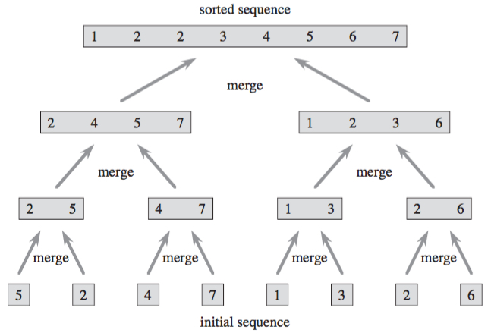
Example: Merge Sort
Combine
Process

Slide 6
Merge demonstration
Goal: Merge left and right arrays in ascending order
if left[i] < right[j]:
merged[k] = left[i]
i += 1
else:
merged[k] = right[j]
j += 1
k += 1
i
left
3 | 5 | 6 | 6 | 9 | 33
j
right
1 | 2 | 6 | 7
k
merged
1
2
3
5
6
6
6
7
9
33

Slide 7
Merge demonstration
Goal: Merge left and right arrays in ascending order
- What if i goes out of bound?
E.g. all the numbers in ‘left’
are smaller than the smallest
number in ‘right’ array?
- Solution: choose the remaining
numbers from the ‘right’ array.
i
left
1 | 3 | 5
j
right
6 | 9 | 11
k
merged

Slide 8
Merge demonstration
Goal: Merge left and right arrays in ascending order
- What if j goes out of bound?
E.g. all the numbers in ‘right’
are smaller than the smallest
number in ‘left’ array?
- Solution: choose the remaining
numbers from the ‘left’ array.
i
left
11 | 14 | 15
j
right
6 | 9 | 10
k
merged

Slide 9
Merge Sort Visualization
https://opendsa-server.cs.vt.edu/embed/mergesortAV

Slide 10
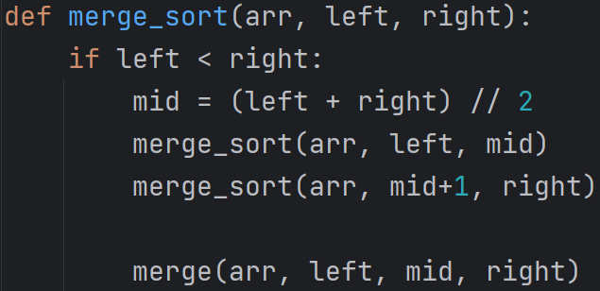
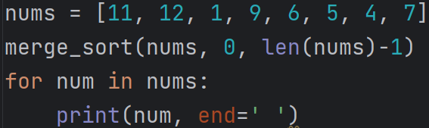

Slide 11
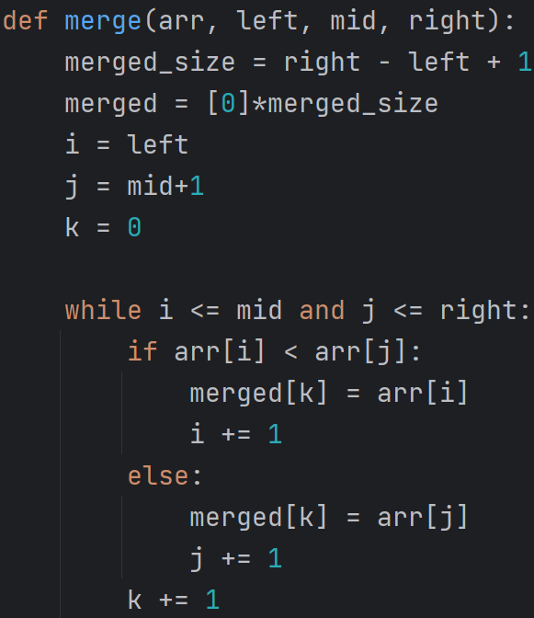
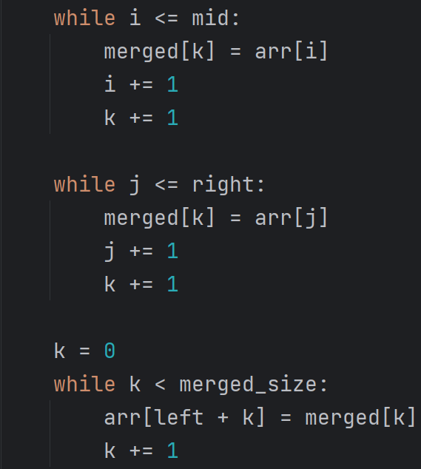

Slide 12
Time & Space complexity?

Slide 13
Quicksort
pivot
11
12
1
9
6
5
4
7
1
6
5
4
7
9
12
11
Choose a number from the list (pivot)
Move all the smaller numbers to the left of the pivot
Move all the larger numbers to the right of the pivot
Now, the pivot is in its correct position
However, the left and right side may not be sorted yet
Recursively perform the same process for left and right sub-array

Slide 14
Quicksort
1
6
5
4
7
9
12
11
1
4
6
5
9
11
12
5
6

Slide 15
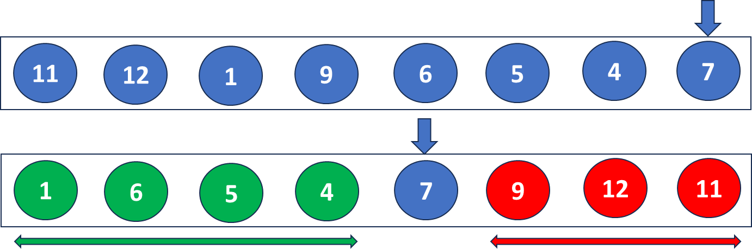
Quicksort
Implementation Challenges:
Swaps/operations needs to be in-place
Not feasible to use extra space/array in each recursive call
We want to use the same array while sorting
arr
arr

Slide 16
Quicksort
Partitioning
pivot
low
11 | 12 | 1 | 9 | 6 | 5 | 4 | 7
high
Two pointers – i and j
j is used to search the smaller numbers
i represents the possible location where smaller numbers can be inserted
Initially, i=low j=low
i, j
11 | 12 | 1 | 9 | 6 | 5 | 4 | 7
i
j
1 | 12 | 11 | 9 | 6 | 5 | 4 | 7
i
i
j

Slide 17
i
j
Partitioning cont
1 | 12 | 11 | 9 | 6 | 5 | 4 | 7
i
i
j
1 | 6 | 11 | 9 | 12 | 5 | 4 | 7
i
j
1 | 6 | 11 | 9 | 12 | 5 | 4 | 7
i
i
j
Partition index = i
1 | 6 | 5 | 9 | 12 | 11 | 4 | 7
i
j
1 | 6 | 5 | 9 | 12 | 11 | 4 | 7
i
i
j
1 | 6 | 5 | 4 | 12 | 11 | 9 | 7
i
1 | 6 | 5 | 4 | 7 | 11 | 9 | 12
Finally, place the pivot in its correct position

Slide 18
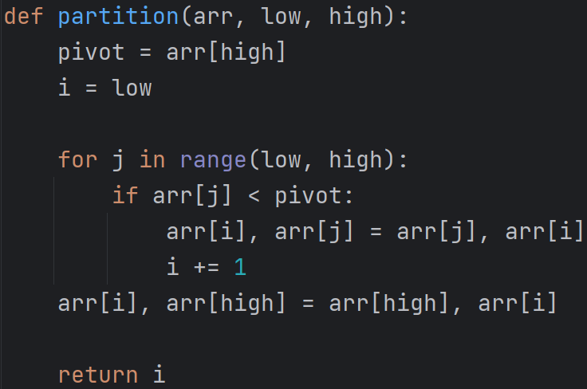

Slide 19
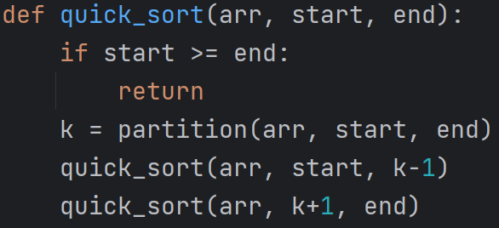
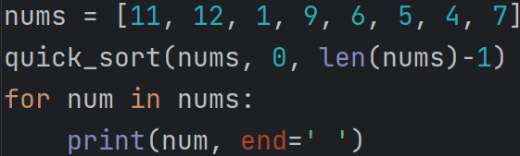

i
j
left | k | right
arr
Time Complexity:
Best-case: O(nlogn)
Average-case: 0(nlogn)
Worst-case: 0(n²)

Slide 20
Attendance

